Slide 1
E54 MH & COMPACTOR
26 JAN

Slide 2
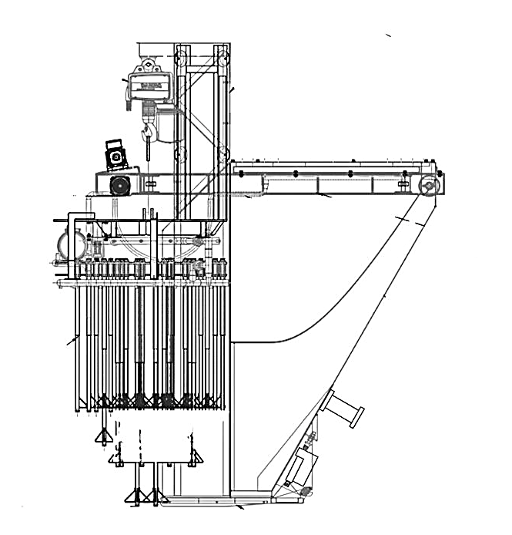
DRAWING
MOBILE HOPPER DRIVE ASSEMBLY
Geared Motor Assembly
Wheel Set and Guide Rollers
A
B
COMPACTOR ASSEMBLY
Vibrating Motor
Electric Hoist
Vibrating Tubes
C
MOBILE HOPPER ASSEMBLY
Discharge Flap Cylinder
Knocking Device

Slide 3
MOBILE HOPPER DRIVE ASSEMBLY
A. MOBILE HOPPER DRIVE ASSEMBLY
Geared Motor Assembly
1.1 Drive Motor
1.2 Gear Box
1.3 Drive Sprocket
1.4 Chain
1.5 Mounting Base
Wheel Set & Guide Rollers
2.1 Driven Sprocket
2.2 Wheel & Shaft
2.3 Roller Bearings
SIDE VIEW
1
2
2

Slide 4
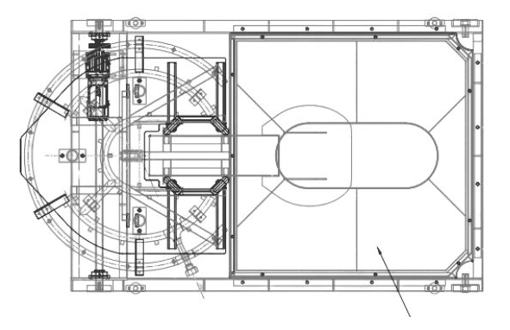
MOBILE HOPPER DRIVE ASSEMBLY
A. MOBILE HOPPER DRIVE ASSEMBLY
Geared Motor Assembly
1.1 Drive Motor
1.2 Gear Box
1.3 Drive Sprocket
1.4 Chain
1.5 Mounting Base
Wheel Set & Guide Rollers
2.1 Driven Sprocket
2.2 Wheel & Shaft
2.3 Roller Bearings
2
TOP VIEW
1
2
2

Slide 5
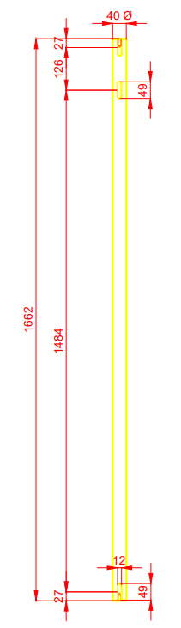
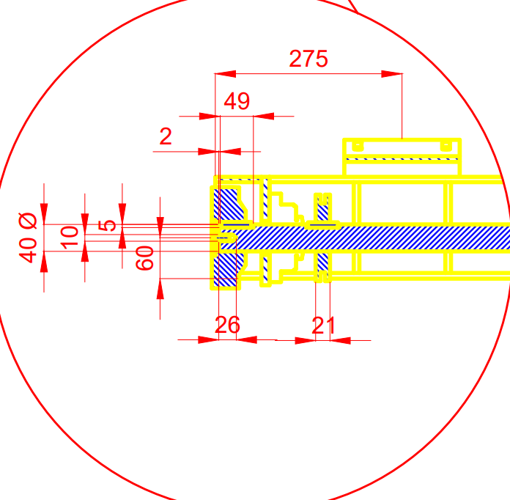
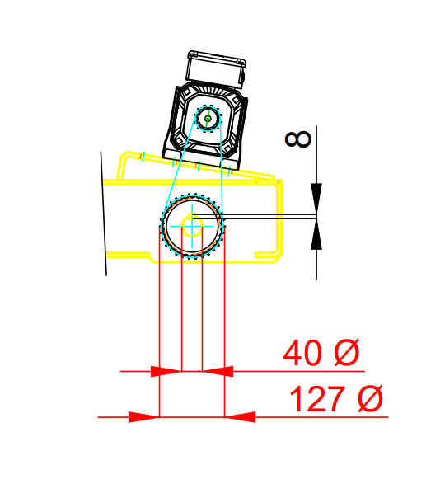
2.2
2.3
2.1
2.2
2. Wheel Set
2.1 Driven Sprocket
2.2 Wheel & Shaft
2.3 Roller Bearings

Slide 6
2.1 Specification OF DRIVEN SPROCKET
COMPONENT | SPECIFICATIONS | BASIC CONDITION SPECIFICATION
2.1 Driven Sprocket (for quotation) | Outside Dia: 127mm Pitch dia: 110mm Inner Dia: 40mm Thickness dia: 21mm Number of Teeth: 30 Material: Carbon Steel Key bar Dimensions: 44mm(L) x 8mm (W) x 8mm (H) Keyway Dimensions: 44mm (L) x 4mm (D) Set Screw: 10mm x 26mm | No signs of wear, such as worn-out teeth and deformation of the tooth profile. Well lubricated with LMI300 LUBCON turmofluid Spray Free from dirt and contaminants. Sprocket intact to the shaft, screw torque= 32 Nm. Vertically aligned drive & driven sprocket using spirit level.

Slide 7
2.2
2.3
2.1
2.2
2. Wheel Set
2.1 Driven Sprocket
2.2 Wheel & Shaft
2.3 Roller Bearings

Slide 8
2.2 Specification OF WHEEL & SHAFT
COMPONENT | SPECIFICATIONS | BASIC CONDITION SPECIFICATION
2.2 Wheel & Shaft | Wheel size : 150mm(OD) x 40mm(ID) x50mm (W) x 4 units Material: SS400 Shaft Diameter: 40mm(Dia) x 1662mm(L) Driven sprocket keyway: 49mm(L) x 4mm (D) x 3 units Key bar: 44mm (L) x 8mm (W) x 8mm (H) x 3 units Material: Steel Guide Roller Size: 70mm(OD) x 25mm(ID) x 30mm(W) x 4 units Material: PA Nylon | No signs of wear and damage. Free from dirt, dust and other accumulated debris on the wheel & track. Wheel lock plate is secured with M10 x 26mm flat screw (Countersunk).

Slide 9
2.2
2.3
2.1
2.2
2. Wheel Set
2.1 Driven Sprocket
2.2 Wheel Shaft & Guide Rollers
2.3 Roller Bearings

Slide 10
2.3 Specification OF BEARING
COMPONENT | SPECIFICATIONS | BASIC CONDITION SPECIFICATION
2.3 Bearing | SKF Flanged Bearing FYK 40 LD Case Material: Composite material Shaft bearing: 40mm (ID) x 43mm (W) x 2 units Housing width: 39mm Temp range: -30 to 120 deg C Type of mounting: flanged Bolt size: M12 x 75mm X 4 units Lubricant: bearing grease LGEP 2/5 Roller Bearing: Deep Groove Ball Bearing SKF 6006 x 4 units Bearing Size: 30mm (ID) x 55mm (OD) x 13mm (W) x 4 units Guide Roller Bearing: SKF 6905 x 4 units Bearing size: 25mm(ID) x 42mm(OD)x 30mm(W) x 4 units Bolt size: M10 x 8 units | No signs of wear and damage. Free from dirt, dust and other accumulated debris. Complete set of M12 nuts & bolts; torque 140Nm 18mm box wrench tool. M10 torque with torque 57 Nm.

Slide 11
DRAWING
MOBILE HOPPER DRIVE ASSEMBLY
Geared Motor Assembly
Wheel Set and Guide Rollers
A
B
COMPACTOR ASSEMBLY
Vibrating Motor
Electric Hoist
Vibrating Tubes
C
MOBILE HOPPER ASSEMBLY
Discharge Flap Cylinder
Knocking Device

Slide 12
MOBILE HOPPER ASSEMBLY
B. MOBILE HOPPER ASSEMBLY
Discharge Flap Cylinder
1.1 Pneumatic Cylinder
1.2 Flap Door Assembly
Knocking Device
2
1

Slide 13
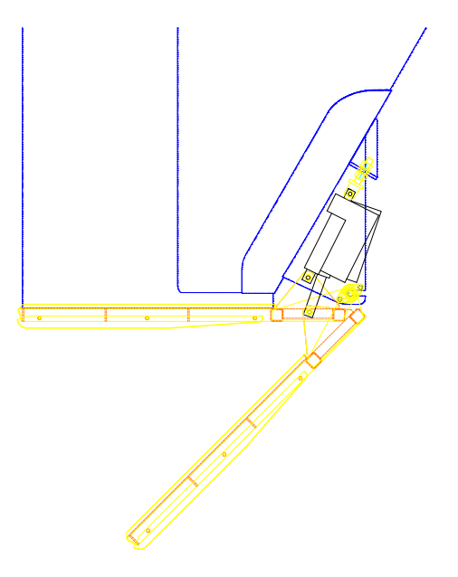
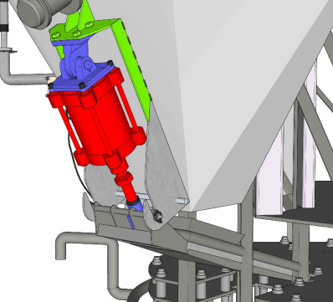
1.1
1.2
Discharge Flap Cylinder
1.1 Pneumatic Cylinder
1.2 Flap Door Assembly

Slide 14
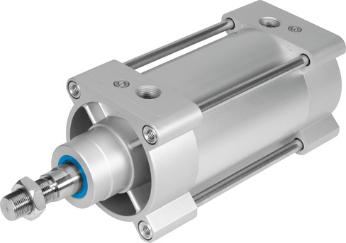
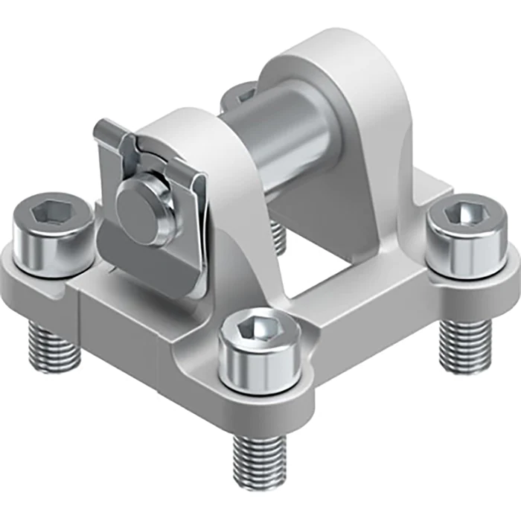
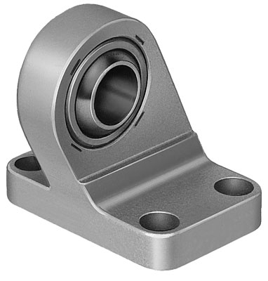
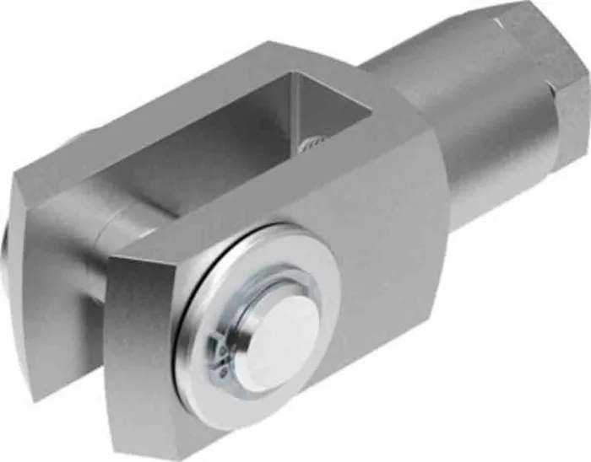
1.1 BASIC SPECS OF PNEUMATIC CYLINDER
Type designation DSBG-160-100-PPVA-N3
Part Number 2029466
Stroke 100 mm
Piston diameter 160 mm
Piston rod thread M36x2
Operating pressure 0.6 bar ... 10 bar
Mode of operation Double-acting
Pneumatic connection G3/4
Ambient temperature -20 ... 80 °C
Rod Clevis
Type designation SG-M36X2
Part Number 174389
Ambient temperature -40 °C ... 150 °C
Clevis Foot
Type designation LSNG-160
Part Number 152599
Ambient temperature -40 °C ... 150 °C
Swivel Flange
Type designation SNC-160
Part Number 152597
Ambient temperature -40 °C ... 150 °C
Rod Clevis Clevis Foot Swivel Flange

Slide 15
1.1 Basic Condition Specification of Pneumatic Cylinder
COMPONENT | SPECIFICATIONS | BASIC CONDITION SPECIFICATION
1.1 Pneumatic Cylinder | FESTO Piston rod cylinder double acting Model: DSGB-160-100-PPV-N3R3T4 Supply pressure: 5-6 bars Stroke: 100 mm Rated Force: 12 KN Pmax: 1Mpa Mounting bolt size: M10 x 60mm (L) | No signs of wear and damage. Free from dirt, dust and other accumulated debris. Complete M10x60x4 mounting bolts with torque 120Nm. Compressed air pressure supply > 5 bars No compressed air leak on cylinder and fittings and 25mm diameter pneumatic tube.

Slide 16
1.1
1.2
Discharge Flap Cylinder
1.1 Pneumatic Cylinder
1.2 Flap Door Assembly

Slide 17
1.2 Specification OF FLAP DOOR ASSEMBLY
COMPONENT | SPECIFICATIONS | BASIC CONDITION SPECIFICATION
1.2 Flap Door Assembly | Max opening angle: 45deg Material: Stainless steel SUS 304 SKF Bearing FYTB 15 Bearing size: 15mm (ID) x 28.6mm (W) Housing Type: Flange Material: Cast Iron Bolt size: M10 x 20mm (L) x 4 units Lubricant: bearing grease SKF LGEP 2/5 | No signs of wear and damage. Free from dirt, dust and other accumulated debris. Max flap door opening at 40 deg No Roasted & ground coffee spillages during hopper loading – flap fully close. Complete set of M10 x 20mm x 4 bolts for flap door bearing with torque of 57Nm 17mm box wrench.

Slide 18
MOBILE HOPPER ASSEMBLY
B. MOBILE HOPPER ASSEMBLY
Discharge Flap Cylinder
1.1 Pneumatic Cylinder
1.2 Flap Door Assembly
Knocking Device
2
1

Slide 19
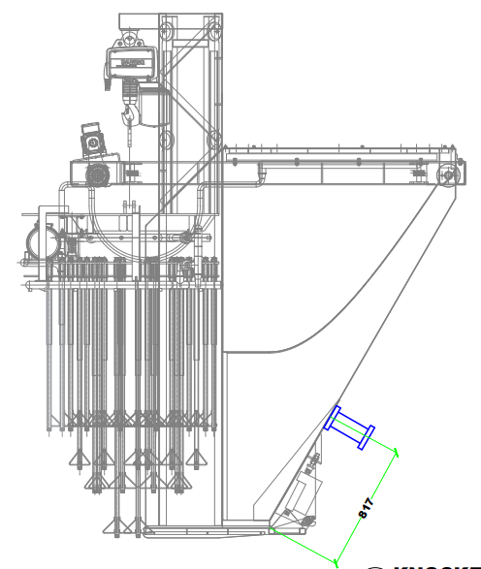
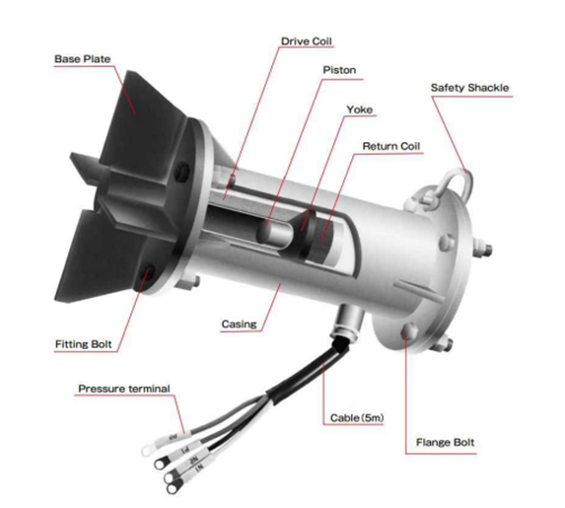
2
2. Knocking Device

Slide 20
2 Specification OF KNOCKING DEVICE
COMPONENT | SPECIFICATIONS | BASIC CONDITION SPECIFICATION
2. Knocking Device | Nippon Magnetic Hammer SIC-1AS Impact Force: 2.7 kg.m/s Input Current: 1.8 amp / Voltage: 220 V Protection: IP65 Base plate Material: SUS304 Mounting Bolt size: M12 x 55mm (L) x 4 | No signs of wear and damage. Free from dirt, dust and other accumulated debris.

Slide 21
DRAWING
MOBILE HOPPER DRIVE ASSEMBLY
Geared Motor Assembly
Wheel Set and Guide Rollers
A
B
COMPACTOR ASSEMBLY
Vibrating Motor
Electric Hoist
Vibrating Tubes
C
MOBILE HOPPER ASSEMBLY
Discharge Flap Cylinder
Knocking Device

Slide 22
DRAWING
2
C. COMPACTOR ASSEMBLY
Vibrating Motor
Electric Hoist
Vibrating Tubes
1
3

Slide 23
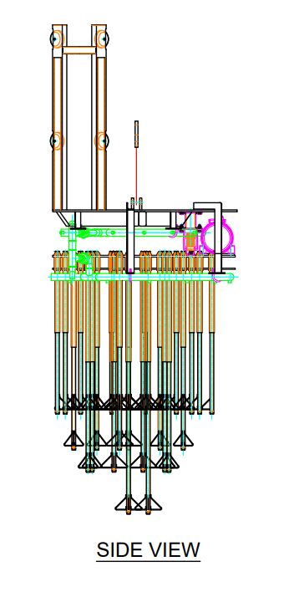
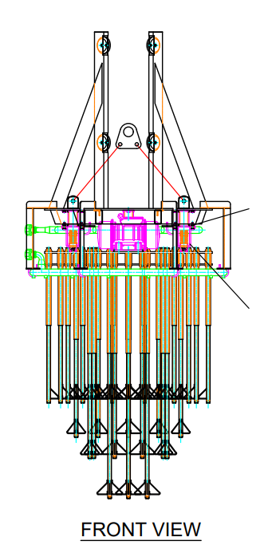
1
COMPACTOR ASSEMBLY
Vibrating Motor
Electric Hoist

Slide 24
1 Specification OF VIBRATING MOTOR
COMPONENT | SPECIFICATIONS | BASIC CONDITION SPECIFICATION
1. Vibrating Motor | Vibrator VENANZETTI VV40B/4 Protection: IP 67 Centrifugal Force: 1750kg Static Moment: 483kgmm Weight: 48kg Power: 1.2KW Max Current: 1.83A Temperature Class: 150degC Mounting Bolt Size: M16 X 100mm(L) Spring Dimension: 50mm (OD) x 87mm (Comp Height) x 3 unit Wire dia: 9mm Mounting bolt size: M14 x 30mm x 18 units Material: SS400 | Free from dirt, dust and other accumulated debris. Complete set of 4 M16 bolt for mounting base torque of 130Nm #24 box wrench. Set vibrating intensity at 20%.

Slide 25
DRAWING
2
C. COMPACTOR ASSEMBLY
Vibrating Motor
Electric Hoist
Vibrating Tubes
1
3

Slide 26
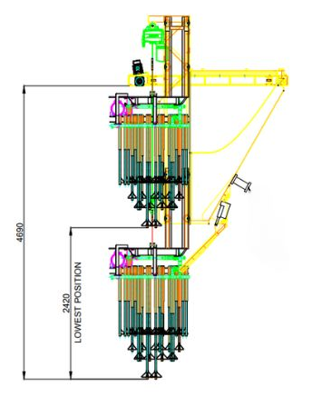
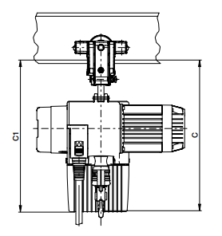
2
COMPACTOR ASSEMBLY
Vibrating Motor
Electric Hoist
Vibrating Tubes

Slide 27
2 Specification OF ELECTRIC HOIST
COMPONENT | SPECIFICATIONS | BASIC CONDITION SPECIFICATION
2. Electric Hoist | Motor size: ZNK 100 A 8/2; 440V 6A Capacity: 2 Tons x 2 speed. Power: 2.61 kW / 440V RPM: 3390 at 60 hz Hoist length: 5m Two Hoist speeds Fast speed: 6m/min Slow Speed: 1.5m/min Protection: IP 55 Control System: 24V contactor Ambient Temp: 40deg C | As per specification Compactor weight: 795 kg Travel: 2.42m (limit switch distance for total vertical travel).

Slide 28
DRAWING
2
C. COMPACTOR ASSEMBLY
Vibrating Motor
Electric Hoist
Vibrating Tubes
1
3

Slide 29
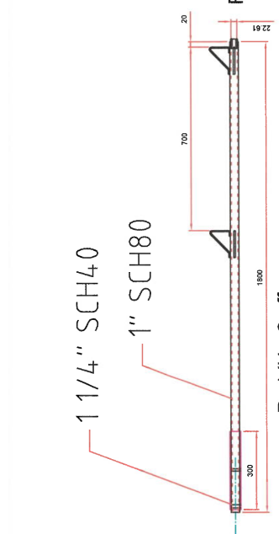
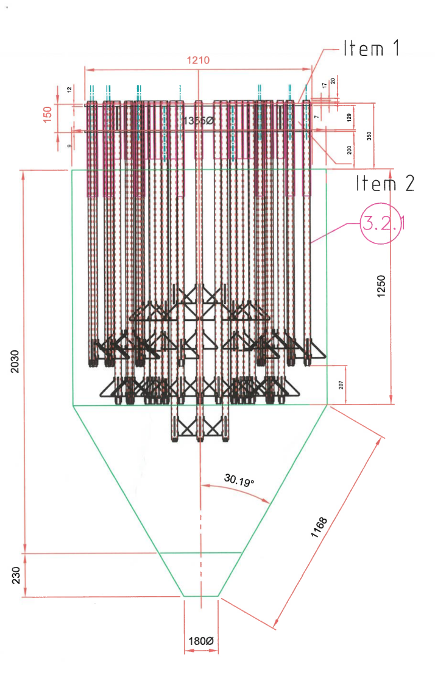
3
COMPACTOR ASSEMBLY
Vibrating Motor
Electric Hoist
Vibrating Tubes

Slide 30
3 Specification OF VIBRATING RODS
COMPONENT | SPECIFICATIONS | BASIC CONDITION SPECIFICATION
3. Vibrating Rods | Material: SUS 304 Diameter: SCH 40 32mm (dia) Diameter: SCH 80 25mm (dia) Total number of rods: 36 units Peripheral rods dimension: 25mm (dia) x 1.4mm(L) X 25 units Inner rods dimension: 25mm (dia) x 1.6mm(L) x 8 units Center Rods dimensions: 25mm (dia) x 1.8mm(L) x 3 units | As per specification Complete 36 units without cracks at welding joints. Travel: 2.42m (limit switch distance for total vertical travel).

Slide 31
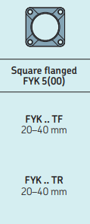
1. MAINTENANCE PLANS
 |  | Maintenance Task
What | E54 MH Wheel Set Lubrication | Lubricate Drive/ driven sprockets and chain using LMI300 LUBCON turmofluid Spray. Apply SKF LGEP 2/5 grease in flange bearing using grease gun. Ensure the grease gun contains the appropriate lubricant - SKF LGEP 2/5. Clean the areas around the fill fittings. Remove the grease release port cover. Grease the bearing with an amount of 187 cm³ ≈ 8 cm push/travel of grease gun with 56mm diameter. Slowly add grease to minimize excessive pressure buildup in the grease cavity. Watch for grease coming out the relief port. Clean excess grease and close port cover.
When | 6M
Where | E54 Mobile Hopper
Which | Turmofluid Spray Grease gun

Slide 32
1. MAINTENANCE PLANS
 |  | Maintenance Task
What | Electric Hoist Motor | Perform hoist maintenance checklist (in the following slide).
When | 1Y
Where | E54 Mobile Hopper
Which | 6mm Allen wrench Ruler or dip stick and steel tape

Slide 33
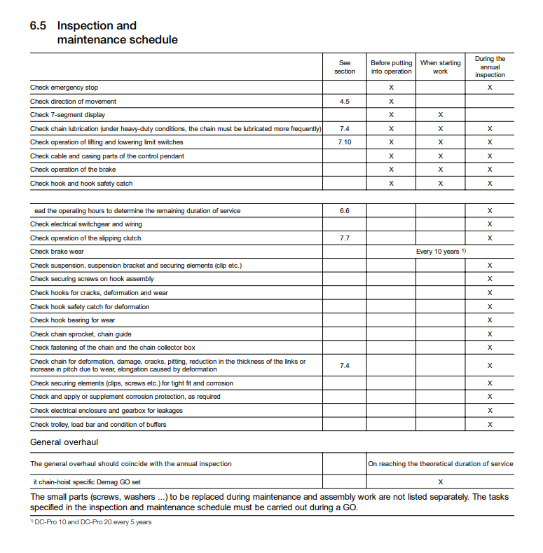
1. Hoist MAINTENANCE Checklist

